Slide 1
INTQEA21QE019
Find travel insurance plan for students
HACKATHON IDEAS
TEAM MEMBERS - JINNA HRUDAYA
ABHAY MISHRA
VENKAT KOUSHIK
MANASA KYAMA
GUNDU NARAYANA HARSHA

Slide 2
OUTLINE
Problem statement
Detailed description
Travel Insurance
Car Insurance
Health Insurance
Results
Conclusion

Slide 3
PROBLEM STATEMENT
Display three lowest international travel insurance plan with amount and insurance provider company
Group of 2 student people (Age 22,21)
For any European country
(Suggested Site: policybazaar however you are free to use any other legitimate site)

Slide 4
DETAILED DESCRIPTION
Find travel insurance plan for students, for 2 people (Age 22 & 21) & any European country, fill further dummy details & display three lowest international travel insurance plan with amount and insurance provider company
2. Get a Car Insurance quote, proceed without car number, keep filling details, give invalid email or phone number & capture the error message
3. Retrieve all Health Insurance menu items and store in a List; Display the same
(Suggested Site: policybazaar.com however you are free to use any other legitimate site)

Slide 5
TRAVEL
INSURANCE
Open Url: www.policybazaar.com
Click the travel insurance icon
Enter the necessary details
Click on add travelers
Enter the mobile number and click on proceed
Click the student check box and enter the details as per the instruction in the description
Sort the price as low to high and display the top 3 insurance providers

Slide 6
CAR
INSURANCE
Click the Car Insurance icon.
Continue without car number.
Enter the car details.
Enter the name, invalid email-id or phone number.
Get a screenshot of error message.

Slide 7
HEALTH
INSURANCE
Click the insurance products.
2. Then just display the list of health insurance.

Slide 8
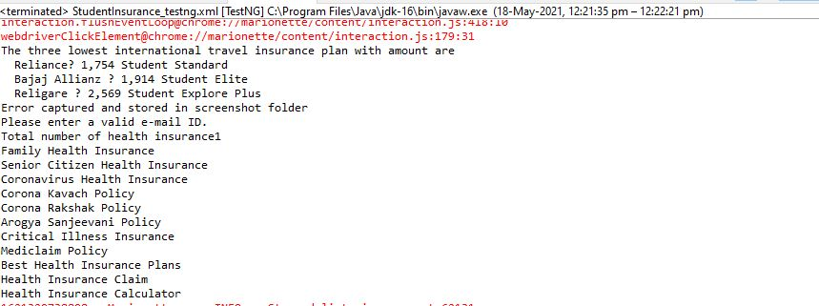
RESULTS
__
- We have successfully displayed the output in the console.

Slide 9
THANK YOU!!

